Slide 1
Understanding COVID-19 Vaccination Volumes in Colorado
Date: August 12, 2024
Analysis and Presentation by:
Rebekkah Alexander
Danita Charles
Barry Maldonado
Aaron Wood

Slide 2
Understanding COVID-19 Vaccination Volumes within Age Demographic, Location, Manufacturer, and Series
We sought to analyze the vaccination rates and potential impacts to volumnes in Colorado based on a number of factors: including the age ranges of those receiving vaccines; the county in which those vaccinations occurred; volumes of vaccinations occurring per manufacturer; and vaccination by series based on data provided by the Colorado Department of Public Health & Environment (“CDPHE”).
For this purposes of this analysis, we opted to specifically avoid the more polarizing topic of vaccination rates within the above segments, focusing instead only on volumes of vaccinations provided.

Slide 3

Vaccine Doses Administered Per County

Slide 4
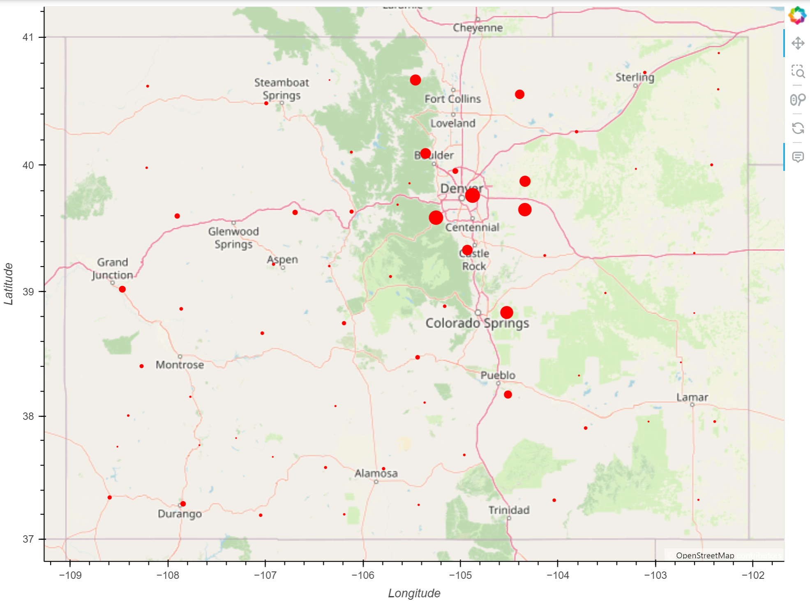
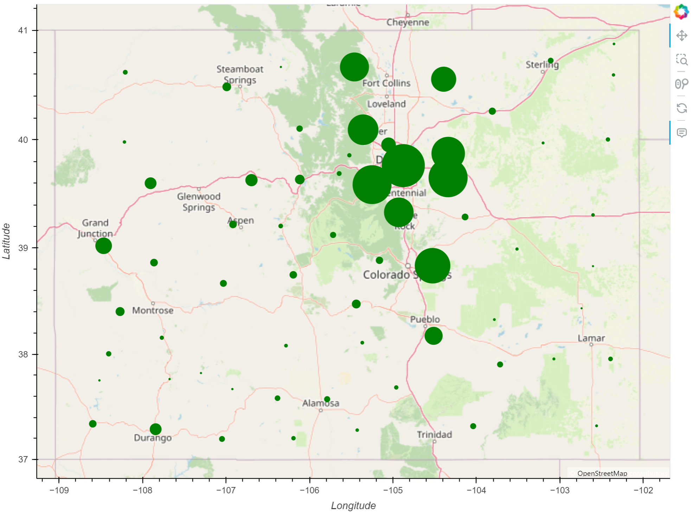
2020
2023
Notes:
Changes in doses administered per county
Smaller counties can barely even been seen in 2020
By 2023, ever dot is at least slightly visible.
Huge jump between 2020 and 2023 in doses administered

Slide 5
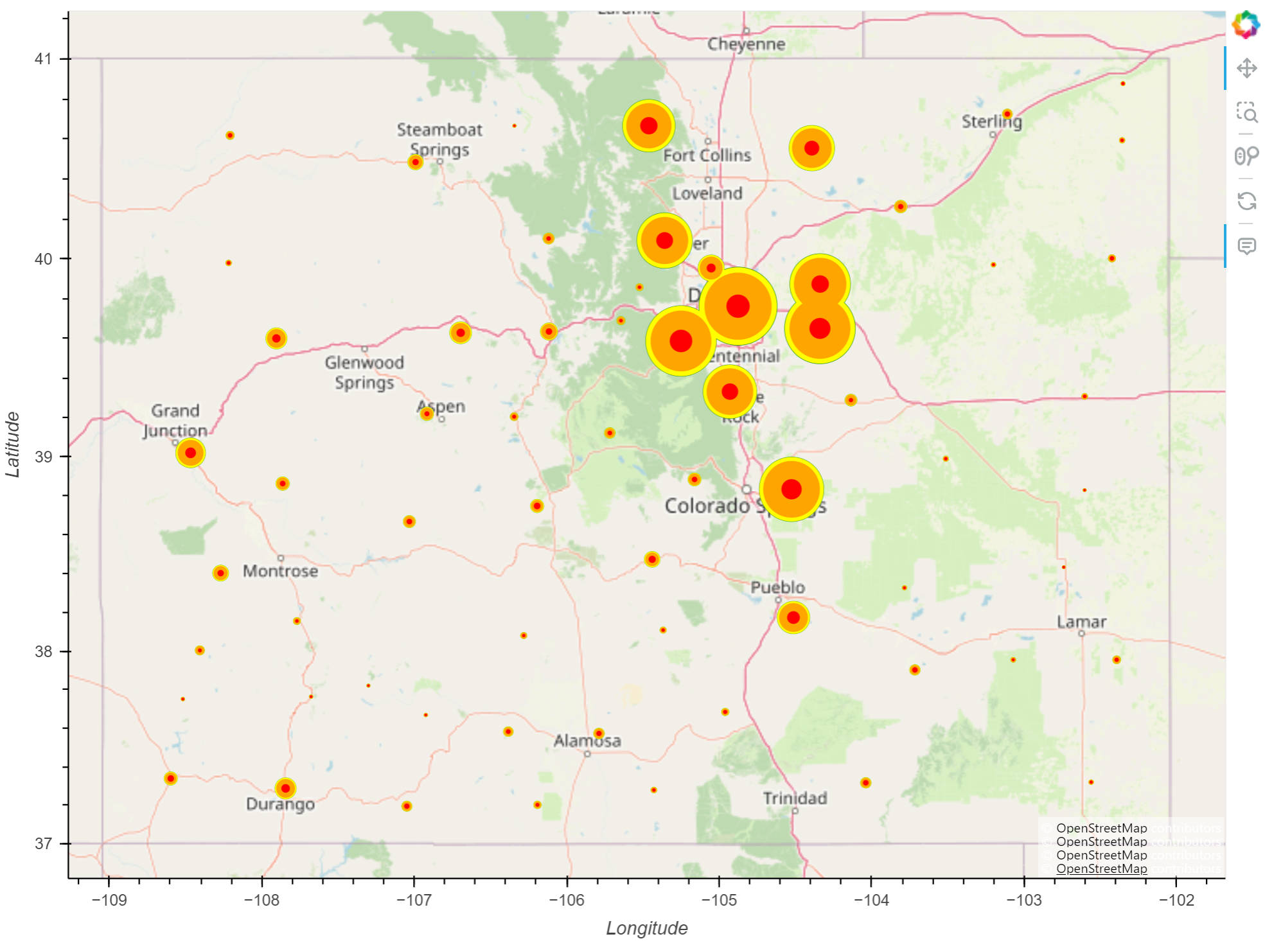
Notes:
Largest jump in vaccines administered between 2020 and 2021, slows down 2022 to 2023
Can barely even see the green behind the yellow

Slide 6
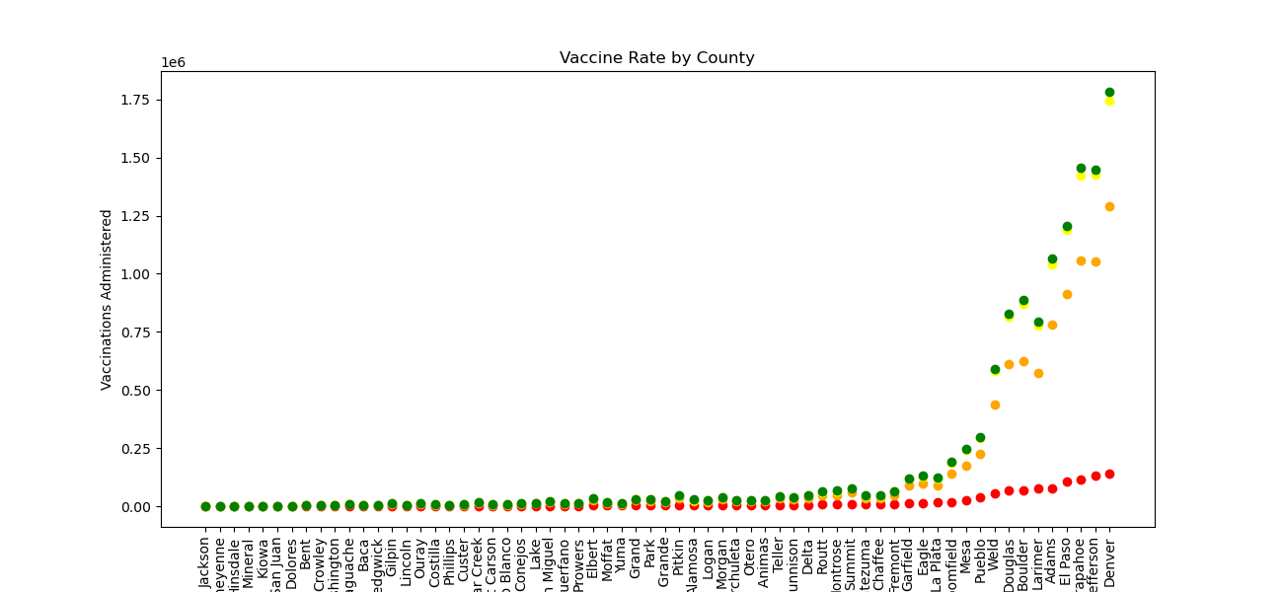
Notes:
Red is 2020, can see there isn’t much variance across the counties
2021, you can really see the jump larger counties take
Another large jump 2022
Very slight increase 2022 to 2023

Slide 7

COVID-19 Vaccination Rates per Series

Slide 8
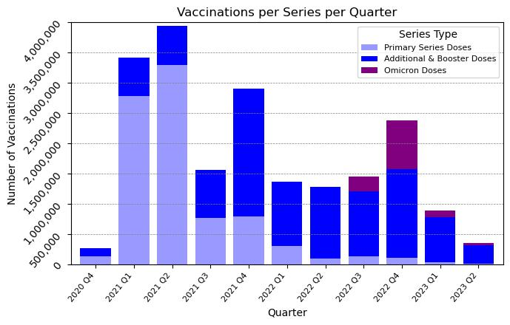
Volumes of Vaccination and Booster Series over Time
The dataset indicates some expected results for the rollout of vaccinations and boosters.
Observable spikes are seen upon first vaccine availability, based on the initial rollouts, subsequent variant, booster recommendations, and Omicron specific vaccinations.

Slide 9
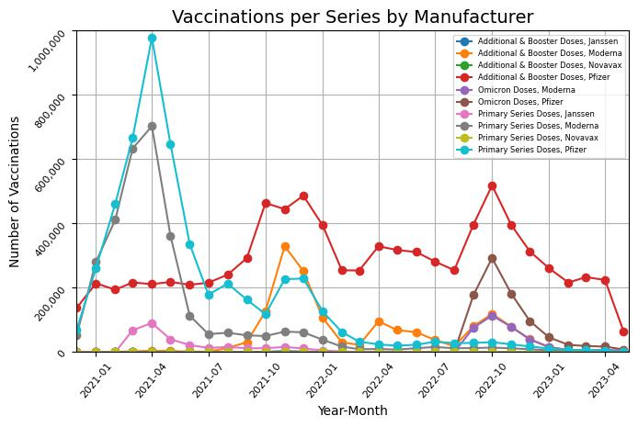
Volumes of Vaccination and Booster Series over Time
A discrepancy appears in the dataset from CDPHE when reviewing the manufacturer of boosters administered at the time Omicron vaccinations became available in Q3 2022.
Volume of Omicron vs. Additional & Booster doses appears to represent a possible mis-identification either at the point of vaccination or point of data referral to CDPHE on the type/series provided.

